Slide 1


Slide 2
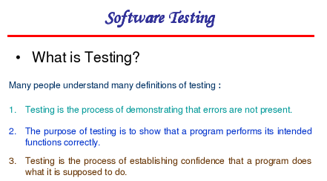

Slide 3
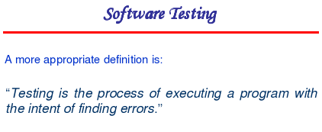

Slide 4
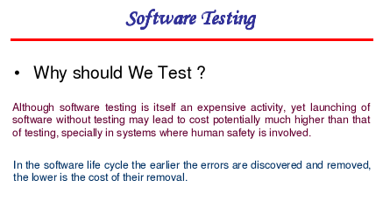

Slide 5
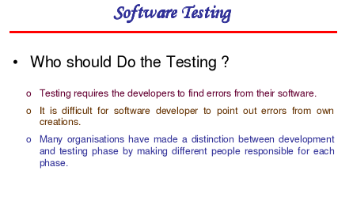

Slide 6
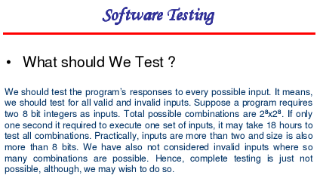

Slide 7
Error, Defect, Bug and Failure
A mistake in coding is called error, error found by tester is called defect, defect accepted by development team then it is called bug ,build does not meet the requirements then it Is failure.

Slide 8
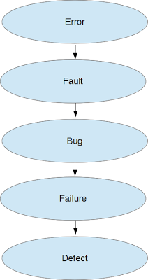
Difference between error, fault, bug, failure and defect

Slide 9
What is an error?
Error is deviation from actual and expected value. It represents mistake made by people.
What is a fault?
Fault is incorrect step, process or data definition in a computer program which causes the program to behave in an unintended or unanticipated manner.
It is the result of the error.
What is a bug?
Bug is a fault in the program which causes the program to behave in an unintended or unanticipated manner. It is an evidence of fault in the program.
What is a failure?
Failure is the inability of a system or a component to perform its required functions within specified performance requirements. Failure occurs when fault executes.
What is a defect?
A defect is an error in coding or logic that causes a program to malfunction or to produce incorrect/unexpected results. A defect is said to be detected when a failure is observed.

Slide 10
1 #include<stdio.h>
2
3 int main ()
4 {
5 int value1, value2, ans;
6
7 value1 = 5;
8 value2 = 3;
9
10 ans = value1 - value2;
11
12 printf("The addition of 5 + 3 = %d.", ans);
13
14 return 0;
15 }

Slide 11
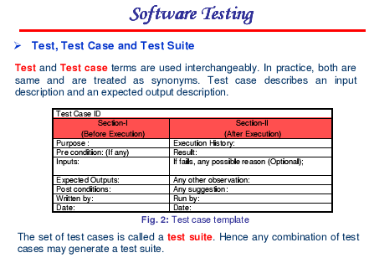

Slide 12
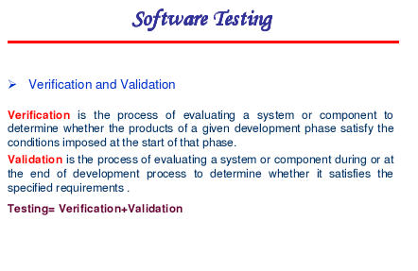

Slide 13
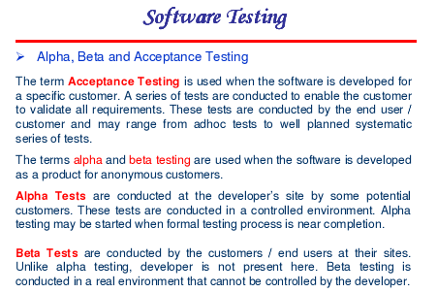

Slide 14
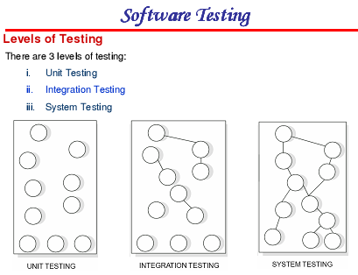

Slide 15
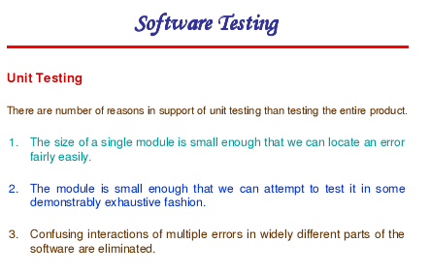

Slide 16
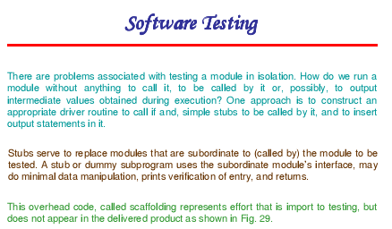

Slide 17
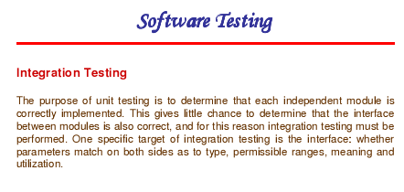

Slide 18
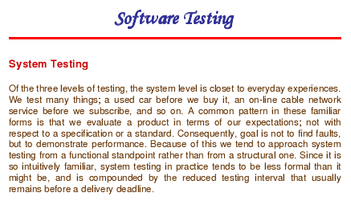

Slide 19
Stress Testing
Exercises the system beyond its maximum design load. Stressing the system often causes defects to come to light.
Stressing the system test failure behaviour. Systems should not fail catastrophically. Stress testing checks for unacceptable loss of service or data.
Particularly relevant to distributed systems which can exhibit severe degradation as a network becomes overloaded.

Slide 20
Regression Testing
Each time a new module is added as part of integration testing
New data flow paths are established
New I/O may occur
New control logic is invoked
Due to these changes, may cause problems with functions that previously worked flawlessly.
Regression testing is the re-execution of some subset of tests that have already been conducted to ensure that changes have not propagated unintended side effects.
Whenever software is corrected, some aspect of the software configuration (the program, its documentation, or the data that support it) is changed.

Slide 21
Contd.
Regression testing is the activity that helps to ensure that changes do not introduce unintended behavior or additional errors.
Regression testing may be conducted manually, by re-executing a subset of all test cases or using automated capture/playback tools.
Capture/playback tools enable the software engineer to capture test cases and results for subsequent playback and comparison.
Regression testing contains 3 diff. classes of test cases:
A representative sample of tests that will exercise all software functions
Additional tests that focus on software functions that are likely to be affected by the change.
Tests that focus on the software components that have been changed.

Slide 22
Contd.
As integration testing proceeds, the number of regression tests can grow quite large.
Regression test suite should be designed to include only those tests that address one or more classes of errors in each of the major program functions.
It is impractical and inefficient to re-execute every test for every program function once a change has occurred.

Slide 23
Regression testing
Regression testing is an important strategy for reducing “side effects.” Run regression tests every time a major change is made to the software (including the integration of new modules).

Slide 24
Black-box Testing
An approach to testing where the program is considered as a ‘black-box’
The program test cases are based on the system specification
Test planning can begin early in the software process

Slide 25
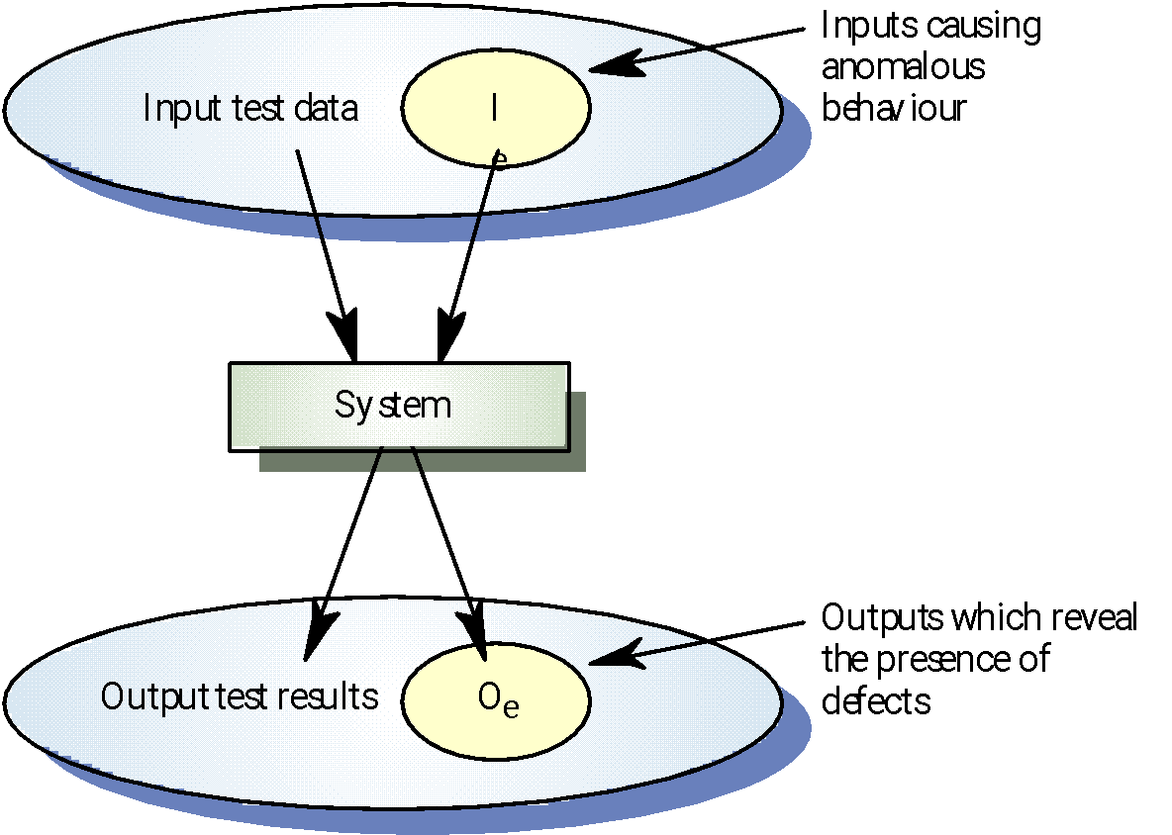
Black-box Testing
Notes:
‹#›

Slide 26
Structural testing
Sometime called white-box testing
Derivation of test cases according to program structure. Knowledge of the program is used to identify additional test cases
Objective is to exercise all program statements (not all path combinations)
Notes:
‹#›

Slide 27
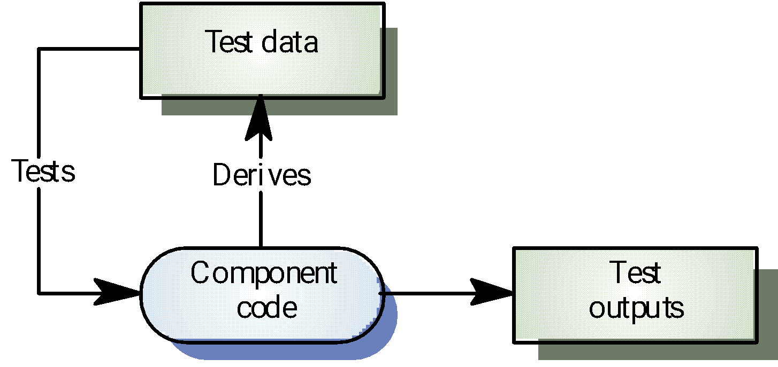
White-box Testing
Notes:
‹#›

Slide 28
i=6;
if x>50 then
y= x+i;
else
y=x+2;
end loop;
Test Case x=51, 53, 189, 210, 320

Slide 29
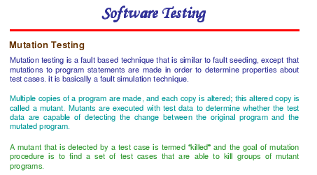

Slide 30
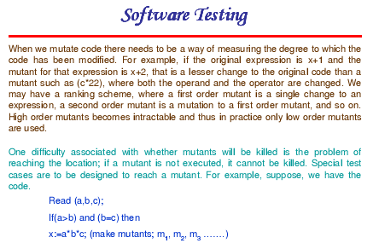

Slide 31
